Slide 1
Unit-4
RBFNN
By: Arjun Saud, Asst. Prof. CDCSIT,TU

Slide 2
Kernel Methods
Kernels or kernel methods (also called Kernel functions) are sets of different types of algorithms that are being used for pattern analysis. They are used to solve a non-linear problem by using a linear classifier.
Sometimes it may be difficult to divide lower dimension dataset using a linear line or hyperplane. Here comes the use of kernel function which takes the points to higher dimensions, solves the problem over there and returns the output.
Consider the situation shown in the figure given in next slide.

Slide 3
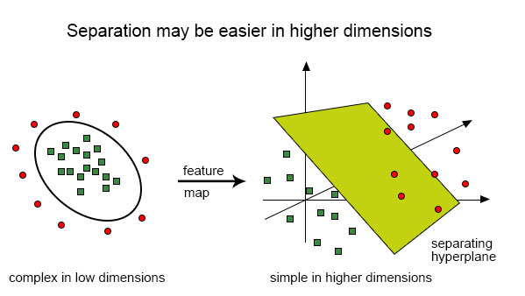
Kernel Methods

Slide 4
Kernel Methods
Consider the following data points: {(1,18), (1,13), (2,9), (3,6), (3,15), (6,11), (6,9), (6,3), (9,5), (9,2), (10,10),(11,5),(12,6), (13,1),(16,3),(18,1)}.
If plot the above dataset in graph, we can clearly see that the dataset is not linearly separable.

Slide 5
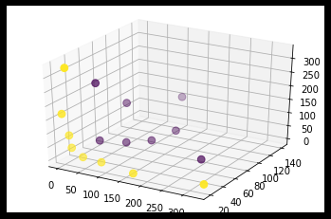
Kernel Methods
Lets transform above data into 3D data using the following polynomial kernel given below and plot the graph of resulting points, we will get the graph like below. From the graph we can clearly see that data points are linearly separable now.

Slide 6
Kernel Methods
There are different types of kernel like linear kernel, polynomial kernel, exponential kernel, Gaussian kernel, etc.
Gaussian kernel and exponential kernel are examples of a radial basis function kernel. The equations given below are Gaussian and exponential kernel functions respectively .

Slide 7
XOR Problem with Radial Basis Function
We know that XOR problem cannot be solved by single layer perceptron because it is not linearly separable.
We have dealt with this problem by introducing a hidden layer with two neurons in MLP.
Alternatively, we can deal with XOR problem using Radial Basis Function (RBF).
To achieve the XOR function we would like to construct a pattern classifier that produces the output 0 for the input patterns (0,0) and (1,1) and output 1 for the input patterns (0,1) and (1,0).

Slide 8
XOR Problem with Radial Basis Function
Lets define a pair of Gaussian hidden functions as below:
RBF centers need to be chosen, assume that c₁=(0,0) and c₂=(1,1).
After applying radial basis function on the XOR input patterns, we will get the transformed input patterns as shown in next slide.
If we draw the transformed data points we will get the graph as below, which is clearly linearly separable.

Slide 9
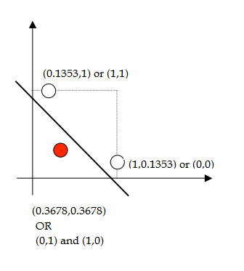
XOR Problem with Radial Basis Function
ϕ₂
x₁ | x₂ | ϕ₁ | ϕ₂
0 | 0 | 1.0 | 0.1353
0 | 1 | 0.3678 | 0.3678
1 | 0 | 0.3678 | 0.3678
1 | 1 | 0.1353 | 1.0
ϕ₁

Slide 10
XOR Problem with Radial Basis Function
Exercise
Solve the XOR problem using RBF by taking (1,0) and (0,1) as centers.
Solve the XOR problem using RBF such that transform 2D data points into 4D data points by taking each of the data point as center. (Hint use the RBF

Slide 11
Radial Basis Function Networks
Radial basis function (RBF) networks are artificial neural networks that typically have three layers: an input layer, a hidden layer with a non-linear RBF activation function and a linear output layer.
Input Layer: This layer consists of m₀ source nodes, where m₀ is the dimensionality of the input vector x.
Hidden Layer: This layer consists of the K computation units (K≤N), where N is number training samples. Each hidden unit is equipped with a radial basis activation function. The RBF is given below.

Slide 12
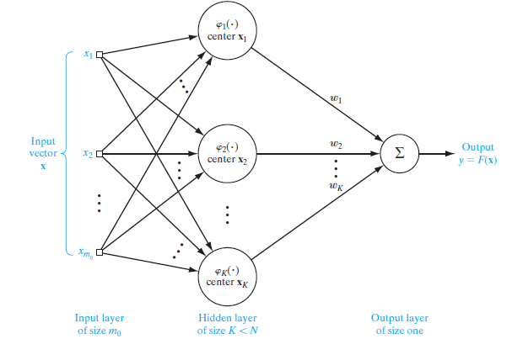
Radial Basis Function Networks
Output Layer: This layer of neural network contains one or more nodes depending upon the need.
Structure of a typical RBF neural network is given below.

Slide 13
Radial Basis Function Networks
RBF networks are typically trained from pairs of input and target values by a two-step algorithm.
In the first step, the center vectors of the RBF functions in the hidden layer are chosen. This step can be performed in several ways; centers can be randomly sampled from some set of examples, or they can be determined using K-means clustering.
The second step simply fits a model with coefficients to the hidden layer's outputs with respect to some objective function.

Slide 14
K-means Clustering
The process of grouping a set of data objects into classes of similar objects is called clustering.
A cluster is a collection of data objects that are similar to one another within the same cluster and are dissimilar to the objects in other clusters.
Clustering is unsupervised machine learning technique.
During clustering of data objects, we need to find similarity between data objects. The most popular similarity measure used in clustering is Euclidean distance.

Slide 15
K-means Clustering
k-means is one of the simplest unsupervised learning algorithms used to solve clustering problem.
The main idea is to define k centers, one for each cluster. The better choice is to place them as much as possible far away from each other.

Slide 16
K-means Clustering
K-means Algorithm
Randomly select K cluster centers.
Calculate the distance between each data point and cluster centers.
Assign the data point to the cluster center that is closest to the data point.
Recalculate the new cluster center using:
If no data point change cluster then stop, otherwise repeat go to step 2.

Slide 17
K-means Clustering
Example
Divide the data points {(1,1), ((2,1), (4,3), (5,4)} into two clusters.
Solution
Let p1=(1,1) p2=(2,1) p3=(4,3) p4=(5,4)
Initial step
Let c1=(1,1) and c2=(2,1) are two initial cluster centers.

Slide 18
K-means Clustering
Iteration 1
Calculate distance between clusters centers and each data points
Thus after first iteration
Cluster 1= {p1} Cluster 2={p2,p3,p4}

Slide 19
K-means Clustering
Iteration 2
New cluster centers are: c1=(1,1) and c2=(11/3,8/3)
Calculate distance between new cluster centers and each data points
Thus after second iteration:
Cluster 1= {p1,p2} Cluster 2={p3,p4}
Repeat this process till no re-assignment of data points to clusters.

Slide 20
K-means Clustering
Iteration 3
New cluster centers are: c1=(3/2,1) and c2=(9/2,7/2)
Calculate distance between new cluster centers and each data points
Thus after third iteration:
Cluster 1= { } Cluster 2={ }
Repeat this process till no re-assignment of data points to clusters.

Slide 21
Training RBF Hidden Layer Using K-means
Initialization: Choose the cluster centers randomly.
Sampling: Draw a sample vector (x) from training set.
Similarity Matching: Find Euclidean distance of the sample vector from each cluster center and determine closest (winning) cluster center. Mathematically, winning cluster center is given by:
Update Cluster Center: Update winning cluster center as below

Slide 22
Training RBF Hidden Layer Using K-means
After deciding RBF centers, next task is to decide value of parameter sigma used in RBF.
We can use following equation to determine value of sigma.
Alternatively we can use following equation to determine the value of sigma.

Slide 23
Training RBF Hidden Layer Using K-means
Example
Consider the XOR problem. Define two RBF centers and calculate the value of sigma for the RBF.
Solution
XOR function is given below
x₁ | x₂ | y
0 | 0 | 0
0 | 1 | 1
1 | 0 | 1
1 | 1 | 0
Let us consider (0,0) and (1,1) are two RBF centers and ϕ₁(x) and ϕ₂(x) are two RBFs.

Slide 24
Training RBF Hidden Layer Using K-means
We know that
Thus,

Slide 25
Training RBF Hidden Layer Using K-means
Alternatively, We know that
Let us choose P=2, thus we get
Thus,

Slide 26
LMS Estimation of Weight Vector
Let us assume that N is the number of input samples in the training set, M is the dimension of hidden layer and C is the number of classes (i.e. number of output nodes)
For notational simplicity assume that
For the properly adjusted weights, following relation must hold

Slide 27
LMS Estimation of Weight Vector
We know that
Above equation can be written in simplified form as below:
However, if the network is not properly trained, above equation is not satisfied. In this case the error term is given as below

Slide 28
LMS Estimation of Weight Vector
Now, the energy function can be written as
Now, Using gradient descent algorithm
Equating above equation with zero and rearranging the terms, we get

Slide 29
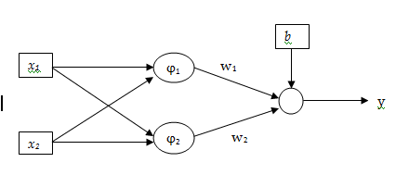
LMS Estimation of Weight Vector
Example
Devise RBF neural network for XOR function using two cluster centers.
Solution
Since we are assuming two cluster centers, structure of RBF network for XOR function will be like below. Assume that Activation function of output layer is step function.

Slide 30
LMS Estimation of Weight Vector
Assume that (0,0) and (1,1) are two RBF centers. Thus, we have following values of sigma for two RBFs.
Thus we have,

Slide 31
LMS Estimation of Weight Vector
Now, we get following output from hidden layer of RBF network.
From LMS estimation method we have
x₁ | x₂ | ϕ₁ | ϕ₂
0 | 0 | 1.0 | 0.1353
0 | 1 | 0.3678 | 0.3678
1 | 0 | 0.3678 | 0.3678
1 | 1 | 0.1353 | 1.0

Slide 32
LMS Estimation of Weight Vector

Slide 33
Learning Procedure for RBF Networks
Learning in RBF network use K-means and LMS of RLS algorithm. This hybrid learning procedure employed in RBF networks is summarized below.
Size of input layer is determined by dimensionality of training sample, let m₀ is the dimensionality of training sample.
Size of input layer is determined by number of clusters, let K=m₁ is the number of clusters.
Use K-means algorithm to determine cluster centers.

Slide 34
Learning Procedure for RBF Networks
Determine value of parameter (RBF width) using following formula
Determine the values of parameters (weights and bias) using LMS.

Slide 35
RBFNN for Function Approximation and Classification
In case of function approximation output layer of RBFNN have only one node.
Whereas in case of classification number of nodes in output layer of RBFNN depends upon the classification problem we are trying to solve.
For classification, you typically have one node per output category, each outputting a score for their respective category.

Slide 36
Bias Variance Tradeoff
The prediction error for any machine learning algorithm can be broken down into three parts:
Bias Error
Variance Error
Irreducible Error
The irreducible error cannot be reduced regardless of what algorithm is used. It is the error introduced from the chosen framing of the problem and may be caused by factors like unknown variables that influence the mapping of the input variables to the output variable.

Slide 37
Bias Variance Tradeoff
Bias is the difference between the average prediction of our model and the correct value which we are trying to predict.
Model with high bias pays very little attention to the training data and oversimplifies the model. It always leads to high error on training and test data.
Bias is the tendency of an estimator to pick a model for the data that is not structurally correct. For example, suppose that we use a linear regression model on a cubic function.

Slide 38
Bias Variance Tradeoff
Bias is caused by underfitting and is the result of simplifying assumptions made by a model to make the target function easier to learn.
Variance is taken as the variability of a model prediction for a given data point.
Model with high variance pays a lot of attention to training data and does not generalize on the data which it hasn’t seen before. As a result, such models perform very well on training data but has high error rates on test data.
Variance is the result of overfitting.

Slide 39
Bias Variance Tradeoff
Variance is error from sensitivity to small fluctuations in the training set. High variance can cause an algorithm to model the random noise in the training data, rather than the intended outputs.
In supervised learning, underfitting happens when a model unable to capture the underlying pattern of the data. These models usually have high bias and low variance.
Overfitting happens when our model captures the noise along with the underlying pattern in data. It happens when we train our model a lot over noisy dataset. These models have low bias and high variance.

Slide 40
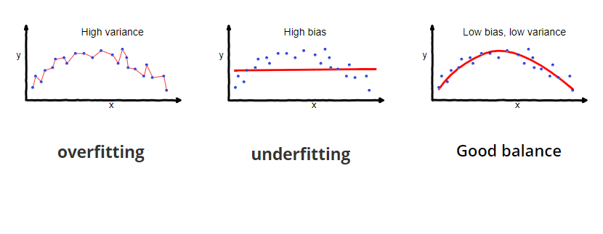
Bias Variance Tradeoff

Slide 41
Bias Variance Tradeoff
If our model is too simple and has very few parameters then it may have high bias and low variance.
On the other hand if our model has large number of parameters then it’s going to have high variance and low bias. So we need to find the good balance without overfitting and underfitting the data. This keeps the MSE minimal.

Slide 42
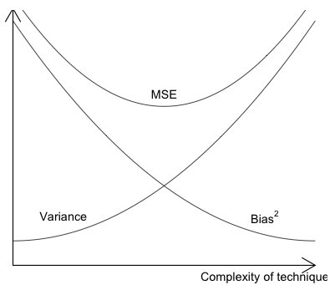
Bias Variance Tradeoff
Error

Slide 43
Regularization
Regularization is a technique used in an attempt to solve the overfitting problem.
A central problem in machine learning is how to make an algorithm that will perform well not just on the training data, but also on new input test data.
Many strategies used in machine learning are explicitly designed to reduce the test error, possibly at the expense of increased training error.

Slide 44
Regularization
In another way we can say that any modiﬁcation we make to a learning algorithm that is intended to reduce its generalization error but not its training error is regularization.
There are many regularization strategies. Some put extra constraints on a machine learning model, such as adding restrictions on the parameter values. Some add extra terms in the objective function. These strategies are collectively known as regularization.

Slide 45
Regularization
A network with large network weights can be a sign of an unstable network where small changes in the input can lead to large changes in the output. This can be a sign that the network has overfit the training dataset and will likely perform poorly when making predictions on new data.
A solution to this problem is to update the learning algorithm to encourage the network to keep the weights small. This is called weight regularization and it can be used as a general technique to reduce overfitting of the training dataset and improve the generalization of the model.

Slide 46
Regularization
How to Penalize Large Weights
There are two parts to penalizing the model based on the size of the weights.
The first is the calculation of the size of the weights, and the second is the amount of attention that the optimization process should pay to the penalty.
Neural network weights are real-values that can be positive or negative, as such, simply adding the weights is not sufficient.

Slide 47
Regularization
How to Penalize Large Weights
There are two main approaches used to calculate the size of the weights, they are:
Calculate the sum of the absolute values of the weights, called L1.
Calculate the sum of the squared values of the weights, called L2.

Slide 48
Regularization
L1 Regularization
In this approach, we penalize the absolute value of the weights as below:
L1 encourages weights to 0.0 if possible, resulting in more sparse weights (weights with more 0.0 values).
The sparsity property induced by L1 regularization has been used extensively as a feature selection mechanism.

Slide 49
Regularization
L2 Regularization
In this approach, we penalize the absolute value of the weights as below:
L2 offers more nuance, both penalizing larger weights more severely, but resulting in less sparse weights.
L2 regularization is also known as weight decay as it forces the weights to decay towards zero (but not exactly zero).

Slide 50
Regularization
Control Impact of the Penalty
The calculated size of the weights is added to the loss objective function when training the network.
Rather than adding each weight to the penalty directly, they can be weighted using a new Hyperparameter called lambda. This controls the amount of attention that the learning process should pay to the penalty.

Slide 51
Regularization
Control Impact of the Penalty
The Lambda Hyperparameter has a value between 0.0 (no penalty) and 1.0 (full penalty). This Hyperparameter controls the amount of bias in the model from 0.0, or low bias (high variance), to 1.0, or high bias (low variance).
If the penalty is too strong, the model will underestimate the weights and underfit the problem. If the penalty is too weak, the model will be allowed to overfit the training data.

Slide 52
Regularization
Dropout Regularization
The term “dropout” refers to dropping out units (both hidden and visible) in a neural network.
Simply put, dropout refers to ignoring certain set of units/neurons, which is chosen at random, during the training phase. These units are not considered during a particular forward or backward pass.
Dropout roughly doubles the number of iterations required to converge. However, training time for each epoch is less.

Slide 53
Regularization
Dropout Regularization
A fully connected layer occupies most of the parameters, and hence, neurons develop co-dependency amongst each other during training which curbs the individual power of each neuron leading to over-fitting of training data.
Dropout is an approach to regularization in neural networks which helps reducing interdependent learning amongst the neurons.

Slide 54
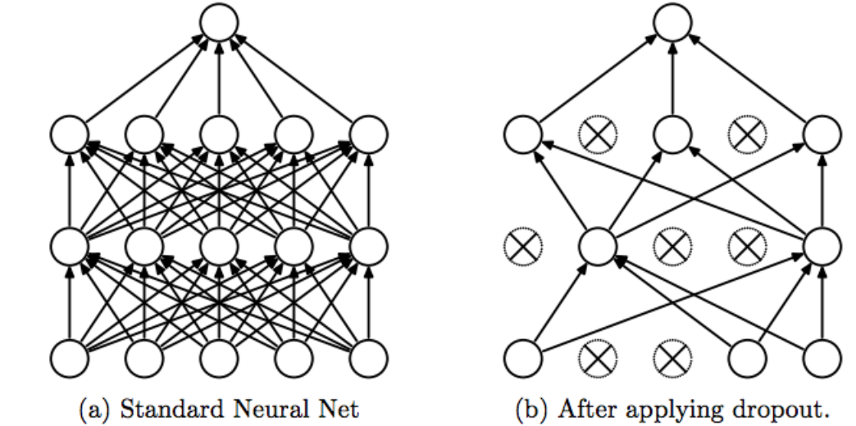
Regularization

Slide 55
Regularization
Data Augmentation
The simplest way to reduce overfitting is to increase the size of the training data. We were not able to increase the size of training data always.
In case of digit identification, there are a few ways of increasing the size of the training data – rotating the image, flipping, scaling, shifting, etc.
This technique is known as data augmentation. This usually provides a big leap in improving the accuracy of the model. It can be considered as a mandatory trick in order to improve our predictions.

